Slide 1

A Product based company
Submitted by:-
Ritika Muskan
MCA 1st Sem
Reg. No- 12204374
Section - D2211
Submitted to:-
Mr. Rishi Chopra

Slide 2
Brief about the Amazon
Amazon.com Inc (Amazon) is an online retailer and web service provider. The company provides products such as apparel, auto and industrial items, beauty and health products, electronics, grocery, books, games, jewellery, kids and baby products, movies, music, sports goods, toys, tools and other related products.
Amazon.com is a vast Internet-based enterprise that sells books, music, movies, housewares, electronics, toys, and many other goods, either directly or as the middleman between other retailers and Amazon.com's millions of customers.

Slide 3
Year of Existence and History
Amazon was founded by Jeff Bezos from his garage in Bellevue, Washington, on July 5, 1994. Initially an online marketplace for books, it has expanded into a multitude of product categories: a strategy that has earned it the moniker The Everything Store.
In 1994 Jeff Bezos, a former Wall Street hedge fund executive, incorporated Amazon.com, choosing the name primarily because it began with the first letter of the alphabet and because of its association with the vast South American river.

Slide 4
Country of Origin & Countries for Business
Amazon Company
Origin- Bellevue, Washington, U.S. U.S
Amazon Global Selling gives access to sell in 18 international marketplaces in Americas (US, Canada & Mexico), Europe (Spain, France, Italy, Germany, Sweden, Netherlands, Poland, Turkey & UK), Middle East (UAE, Saudi Arabia) & Asia-Pacific (Japan, Singapore & Australia).

Slide 5
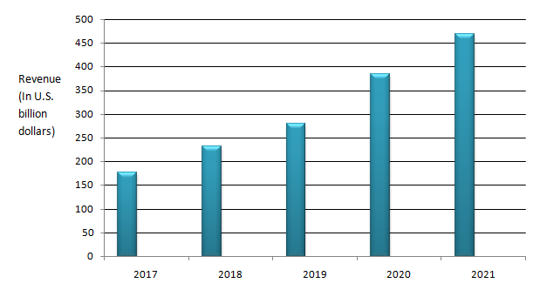
Revenue Last 5 years

Slide 6
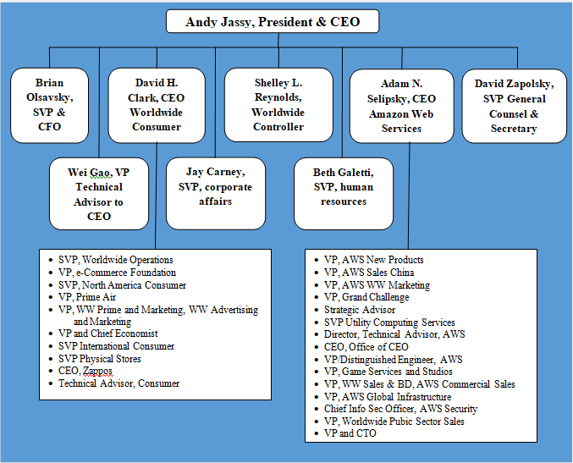
Leadership Hierarchy

Slide 7
Employee Base Country wise
Interactive chart of Amazon (AMZN) annual worldwide employee count from 2010 to 2022. Amazon total number of employees in 2021 was 1,608,000, a 23.88% increase from 2020.
27-Jul-2022 — In 2021, the American multinational e-commerce company, headquartered in Seattle, Washington, employed 1,608,000 full- and part-time employees.

Slide 8
Ranking of Company (Fortune 500)
Amazon ranks No. 2 on Fortune's World's Most Admired Companies.
Amazon that has catapulted to No. 2 position on the Fortune 500 list this year; have seen a remarkable jump to $281 billion revenue and 21% revenue growth in 2019-20.

Slide 9
Technologies used in Amazon
Amazon
Java
Python
My sql
Angular js
Java script

Slide 10
Major Products & Service of the Amazon
Amazon product lines include (books, DVDs, music CDs, videotapes, and software), apparel, baby products, consumer electronics, beauty products, gourmet food, groceries, health and personal-care items, industrial and scientific supplies, kitchen items, jewelry and watches, lawn and garden items, musical instruments,
Amazon services: Delivery and Logistics
Savings, Security, Compliance and DRaaS Development Operations.

Slide 11
Operations verticals of the Amazon
Amazon sources and develops its own private-label products (AmazonBasics, Kindle) and develops services like Prime or, again, Kindle. These are all examples of vertical integration. There's no other company at this scale with a similar approach of both horizontal and vertical integration.
Amazon has been obsessed with vertical integration since its inception. The company's strategy has been to develop products that meet its customers' needs, optimize them to the limit, and then offer them to third parties to make their development and operation profitable.

Slide 12
Role’s I am intrested in the Amazon.
Software Development Engineer

Slide 13
Packages offered by the Company
Role- Software Development Engineer
Package:- 8 Lakhs to 48 Lakhs

Slide 14
Visit To Lpu

Slide 15
Pros and Cos According to you

Slide 16
List of Weblinks Articles
https://en.wikipedia.org/wiki/Amazon_(company)
https://www.aboutamazon.com/what-we-do
https://www.aboutamazon.com/news/innovation-at-amazon/new-technologies-to-improve-amazon-employee-safety
https://fortune.com/company/amazon-com/fortune500/
https://gadgets360.com/internet/news/amazon-total-employees-count-worldwide-798000-us-staff-500000-2173125

Slide 17

A Product based company
Microsoft

Slide 18
Brief about the Microsoft
Microsoft Corporation is an American multinational technology corporation which produces computer software, consumer electronics, personal computers, and related services headquartered at the Microsoft Redmond campus located in Redmond, Washington, United States
Microsoft is an American multinational computer technology corporation whose history started 4th April 1975. Formed by Harvard College dropout, Bill Gates and his childhood friend Paul Allen, Microsoft has now become the biggest software company. It is also one of the most valuable companies in the world.

Slide 19
Year of Existing
Microsoft was founded by Bill Gates and Paul Allen on April 4, 1975, to develop and sell BASIC interpreters for the Altair 8800. It rose to dominate the personal computer operating system market with MS-DOS in the mid-1980s, followed by Windows.

Slide 20
Country of Origin & Country for Business:
Microsoft Company
Microsoft released its first product which is called the Altair BASIC. The company's first international office was founded on November 1, 1978, in Japan, entitled "ASCII Microsoft" (now called "Microsoft Japan")
Microsoft operates in 190 countries.

Slide 21
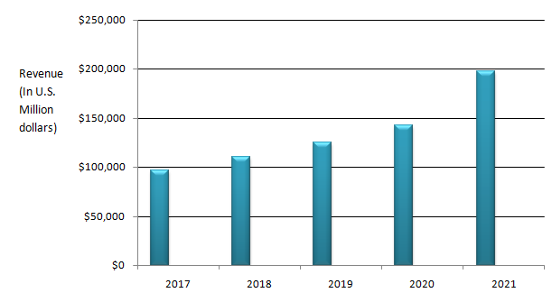
Revenue as per NSE/NYSE

Slide 22
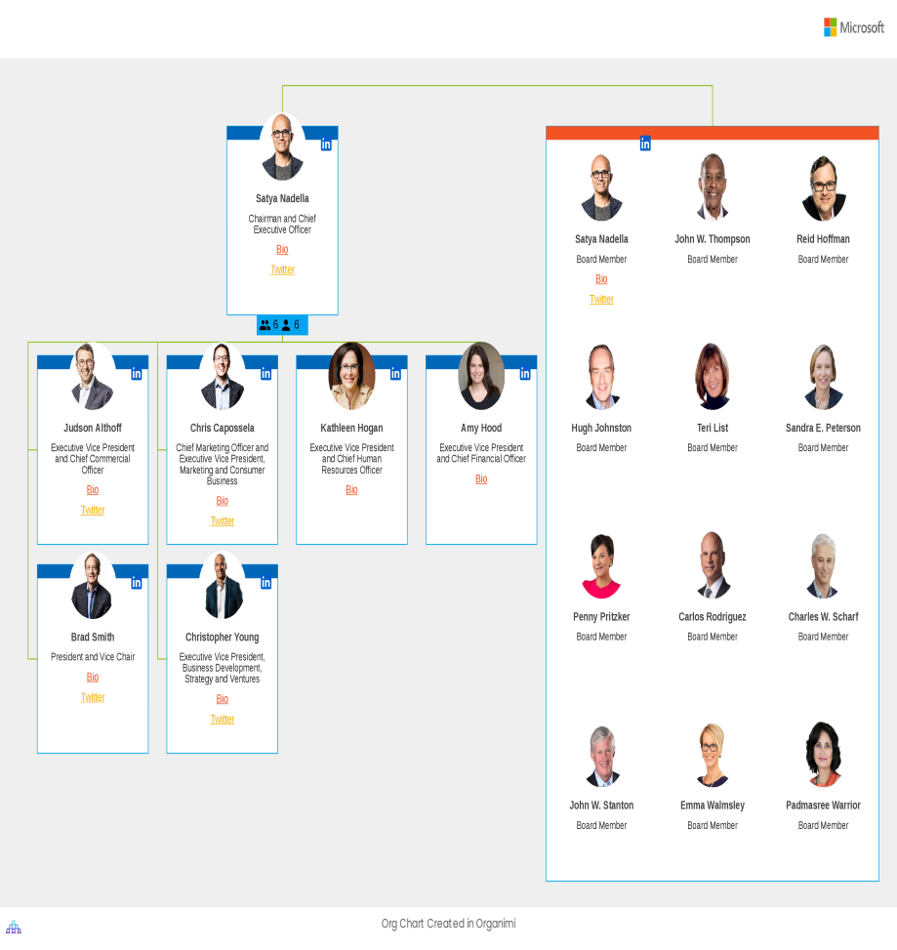
Leadership Hirerachy

Slide 23
Employee Base country wise
Microsoft Corporation is a major international technology company, with around 122,000 full-time employees in the United States in fiscal year 2022. Another 99,000 of Microsoft's full-time employees are located outside the company's home market bringing the total number of full-time employees worldwide to around 221,000. The employees of Microsoft's are distributed over four main business units - operations, product research and development, sales and marketing, and general and administration.
34% of Microsoft employees are Indians. 28% of IBM employees are Indians

Slide 24
Ranking of Company (Fortune 500)
Microsoft ranks No. 14 on Fortune’s 500.

Slide 25
Technologies used in Microsoft
Microsoft
VB.net
Asp.net
Azure
MVC
Jquery
Java script
Xml

Slide 26
Operations verticals of the Microsoft
We develop and market software, services, and hardware that deliver new opportunities, greater convenience, and enhanced value to people's lives.
Microsoft Search has two types of verticals, out of the box or default and custom verticals. The default verticals, such as All, Files, and People, create easy access to the most commonly used search results.

Slide 27
Major Products & Service of the Amazon
Microsoft Azure. Azure is Microsoft's big enterprise cloud, offered as a PaaS and IaaS service. ...
MS Office 365.
Microsoft SQL Server with MS System Center. ...
Enterprise Mobility Suite. ...
Microsoft Visual Studio

Slide 28

Role’s I am intrested in the Amazon.
Software Development Engineer

Slide 29
Packages offered by the Company
Role- Software Development Engineer
Package:- 12 Lakhs to 50 Lakhs

Slide 30
Visit To Lpu

Slide 31
Pros. & Cons. Of Microsoft

Slide 32
Reference
https://www.statista.com/statistics/1032154/microsoft-employees-by-location/
https://en.wikipedia.org/wiki/Microsoft
https://www.history.com/this-day-in-history/microsoft-founded
https://fortune.com/company/microsoft/fortune500/

Slide 33

A Service based company

Slide 34
Brief about the Wipro
Wipro Limited is an Indian multinational corporation that provides information technology, consulting and business process services.
Wipro Limited (formerly, Western India Palm Refined Oils Limited) is an Indian multinational corporation that provides information technology, consulting and business process services.

Slide 35
Year of Existence and History
Infosys Limited is an Indian multinational information technology company that provides ... Founded, 2 July 1981; 41 years ago
The company was incorporated on 29 December 1945 in Amalner, India, by Mohamed Premji as Western India Vegetable Products Limited, later abbreviated to Wipro. It was initially set up as a manufacturer of vegetable and refined oils under the trade names of Kisan, Sunflower, and Camel.
Established in 1981, Infosys is a NYSE listed global consulting and IT services company with more than 345k employees.

Slide 36
Country of Origin & Countries for Business
Wipro
Origin- 29 December 1945 in Amalner, India
Amazon Global Selling gives access to sell in 18 international marketplaces in Americas (US, Canada & Mexico), Europe (Spain, France, Italy, Germany, Sweden, Netherlands, Poland, Turkey & UK), Middle East (UAE, Saudi Arabia) & Asia-Pacific (Japan, Singapore & Australia).
A company recognized globally for its comprehensive portfolio of services, strong commitment to sustainability and good corporate citizenship, we have over 250,000 dedicated employees serving clients across 66 countries.

Slide 37
Revenue Last 5 years
30 September 2022 :
30 September 2021 :
30 September 2020 :
30 September 2019 :
30 September 2018 :

Slide 38
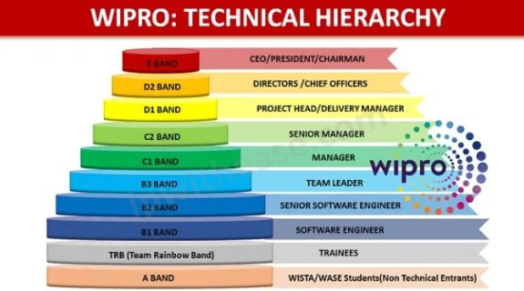
Leadership Hierarchy
The final and highest band consists of the chief executives like CEO, CFO, CTO, president, chairman, Board of Directors, etc…

Slide 39
Employee Base Country wise

Slide 40
Ranking of Wipro (Fortune 500)
Wipro ranks No. 32 on Fortune's World's Most Admired Companies.

Slide 41
Technologies used in Wipro
Wipro
Applications Artificial & Augmented Intelligence Business Process Business Solutions Cloud.
Consulting Cybersecurity Data & Analytics Design & Experience Digital Marketing & Interaction.
Engineering Infrastructure Sustainability Talent Cloud.

Slide 42
Operations verticals with the clients

Slide 43
Major Services:
Amazon services: Delivery and Logistics
Savings, Security, Compliance and DRaaS Development Operations.
Microsoft Azure. Azure is Microsoft's big enterprise cloud, offered as a PaaS and IaaS service. ...
MS Office 365.
Microsoft SQL Server with MS System Center. ...
Enterprise Mobility Suite. ...
Microsoft Visual Studio

Slide 44

Role’s you are intrested in the company.
Software Development Engineer

Slide 45

Packages offered by the Wipro
Role- Software Development Engineer
Package:- 4 Lakhs to 10 Lakhs per Annum

Slide 46
Visit To Lpu

Slide 47
Pros and Cos According to you

Slide 48
List of Weblinks Articles
https://en.wikipedia.org/wiki/Wipro#:~:text=History%20of%20Wipro,-Early%20years&text=The%20company%20was%20incorporated%20on,Kisan%2C%20Sunflower%2C%20and%20Camel.
https://www.statista.com/statistics/712144/wipro-employee-number-by-region/
https://www.wipro.com/investors/last-5-years-data/
https://www.statista.com/statistics/910359/india-wipro-revenue/

Slide 49

A Service based company

Slide 50
Brief about the Infosys
Infosys Limited is an Indian multinational information technology company that provides business consulting, information technology and outsourcing services ...
Infosys Limited is an Indian multinational information technology company that provides business consulting, information technology and outsourcing services. The company was founded in Pune and is headquartered in Bangalore.
Today Infosys is a huge company and has more than 2 lakh employees. Its revenue is US$14 billion today. This company is now the 4th largest company in India. It has market capitalization of $100 bn.

Slide 51
Year of Existence and History
Established in 1981, Infosys is a NYSE listed global consulting and IT services company with more than 345k employees.
Established in 1981, Infosys is a NYSE listed global consulting and IT services company with more than 345k employees.
Infosys is an Indian Multinational Corporation. It is the 3rd largest IT service provided in India. It offers IT solutions to businesses. 1981 - It was established by Narayana Murthy in Pune with an initial capital investment of $250.

Slide 52
Country of Origin & Countries for Business
Infosys
Origin- 2 July 1981 in Pune,India
As on March 31, 2022, the Company is spread across 247 locations in more than 54 countries. This document provides details of key locations where our offices are situated across North America, Europe, Asia Pacific, India and South Africa.

Slide 53
Revenue Last 5 years

Slide 54
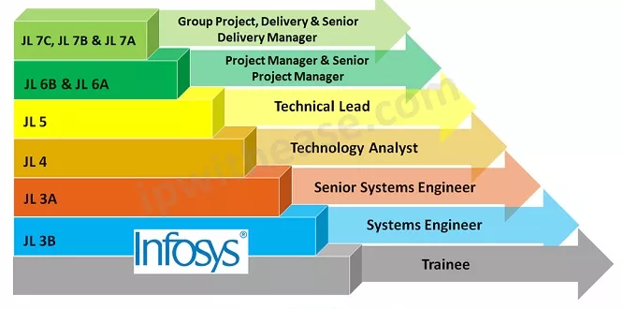
Leadership Hierarchy

Slide 55
Employee Base Country wise

Slide 56
Ranking of Company (Fortune 500)
Infosys ranks No. 16 on Fortune’s 500.
Infosys is the second-largest Indian IT company, after Tata Consultancy Services, by 2020 revenue figures, and the 602nd largest public company in the world, according to the Forbes Global 2000 ranking. On 24 August 2021, Infosys became the fourth Indian company to reach $100 billion in market capitalization.

Slide 57
Technologies used in Infosys
Infosys
Artificial Intelligence, Cloud, API, Microservices, Cybersecurity, IT BizOps. ,DevSecOps.
Infosys uses 103 technology products and services including HTML5 , Google Analytics , and jQuery , according to G2 Stack. Infosys is actively using 82 technologies for its website, according to BuiltWith. These include Viewport Meta , IPhone / Mobile Compatible , and LetsEncrypt .

Slide 58
Operations verticals of the Infosys
High Technology.
Industrial Manufacturing.
Information Services & Publishing.
Life Sciences.
Logistics & Distribution.
Media and Entertainment.
Personalized digital experiences.
Predictive enterprise business processes.
AI-driven intelligent automation.
Agile, resilient enterprise with nimble processes, IT and people.
Hybrid cloud with interoperable public and private cloud applications, platforms and infrastructure.

Slide 59
Major Services:
Amazon services: Delivery and Logistics
Savings, Security, Compliance and DRaaS Development Operations.
Microsoft Azure. Azure is Microsoft's big enterprise cloud, offered as a PaaS and IaaS service. ...
MS Office 365.
Microsoft SQL Server with MS System Center. ...
Enterprise Mobility Suite. ...
Microsoft Visual Studio

Slide 60

Role’s you are intrested in the company.
Software Development Engineer

Slide 61

Packages offered by the Company
Role- Software Development Engineer
Package:- 6 Lakhs to 20 Lakhs per Annum

Slide 62
Visit To Lpu

Slide 63
Pros and Cons According to you

Slide 64
List of Weblinks Articles
https://www.infosys.com/content/dam/infosys-web/en/techcompass/it-bizops.html
https://en.wikipedia.org/wiki/Infosys
https://www.moneycontrol.com/financials/infosys/profit-lossVI/IT
https://www.infosys.com/about/history.html#:~:text=Established%20in%201981%2C%20Infosys%20is,of%20approximately%20US%24%2071.41%20billion.

